Slide 1
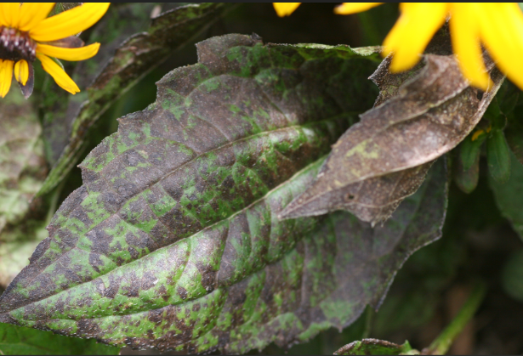
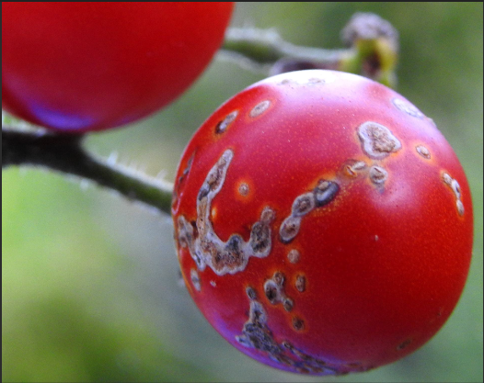
Crop name | Disease Name | Symptoms | Disease Picture
Tomato | Septoria leaf | Spots round to irregular spots with grey center and dark margin son leaves are seen
Tomato | Bacterial stem and fruit canker | Appears as spots on leaves, stems and fruits and as wilting of leaves and shoots while blister like spots appear on margins of leaves

Slide 2
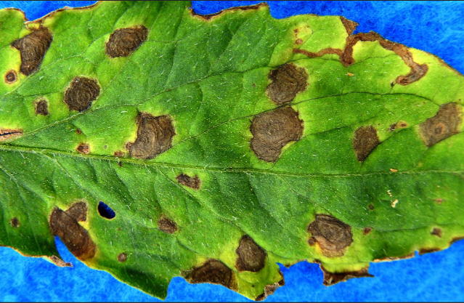
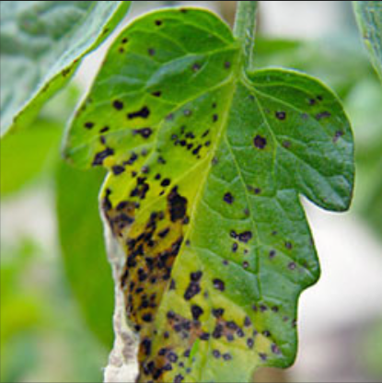
Crop name | Disease Name | Symptoms | Disease Picture
Tomato | Early Blight | Occurs on the foliage at any stage of growth .Fungus causes leaf spots and blight on stems same as on leaves .
Tomato | Bacterial leaf spot | Infected leaves show small brown water soaked circular spots surrounded by yellowish halo .Mostly on older plants causing serious defoliation .

Slide 3
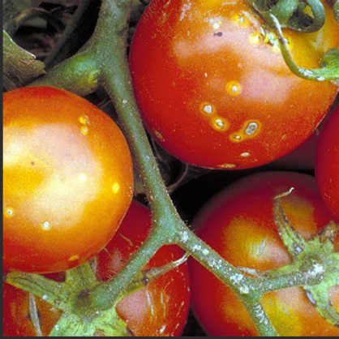
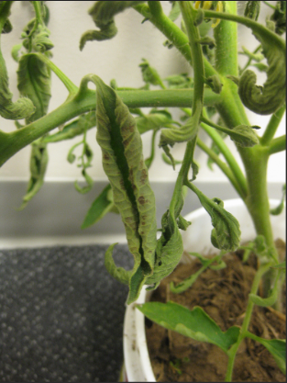
Crop name | Disease Name | Symptoms | Diseases Picture
Tomato | Bacterial wilt | Rapid and complete wilting of normal grownup plants. Lower leaves may drop .Pathogen confined to vascular regions with yellow brown discoloration of tissues.
Tomato | Leaf Curl | Severe stunting of plants with downward rolling and crinkling of leaves .Older leaves become leathery and brittle. Nodes and internodes are significantly reduced in size.

Slide 4
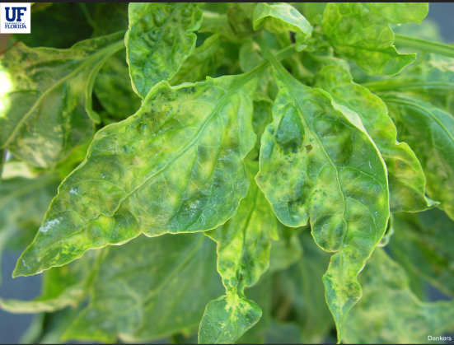
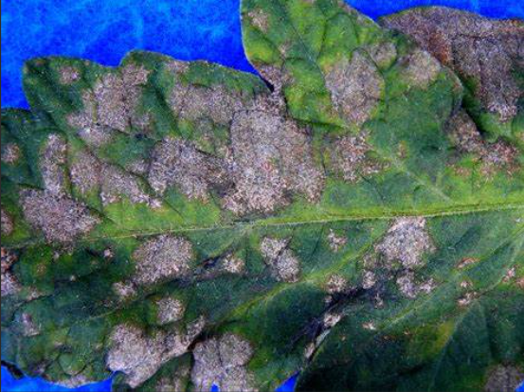
Crop name | Disease Name | Symptoms | Diseases Picture
Tomato | Mosaic | Presence of light and dark green mottling of leaves accompanied bywilting of young leaves associated with distorted, puckered, and smaller leaflets .Also indented leaves resuling in fern leaf symptoms
Tomato | Powdery mildew | A white powdery coating of fungal growth appears on the leaf surface with dwarfed leaves

Slide 5
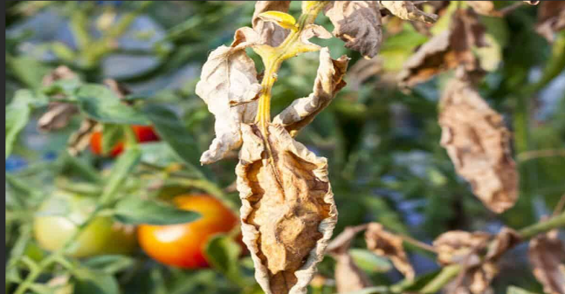
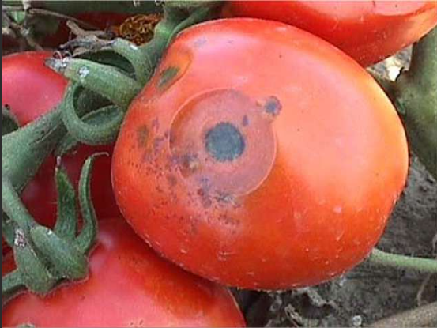
Crop name | Disease Name | Symptoms | Diseases Picture
Tomato | Fusarium Wilt | One of the most serios diseases of tomato crop .Rapid and complete wilting of normal grown up plants . Confined to vascular region with clearing of veinlets and chlorosis of leaves is seen.
Tomato | Black Eye Rot | It’s a serios disease in all the tomato growing areas .Appears as greyish green or brown water soaked spots that usually occurs where th fruit touches the soil.

Slide 6
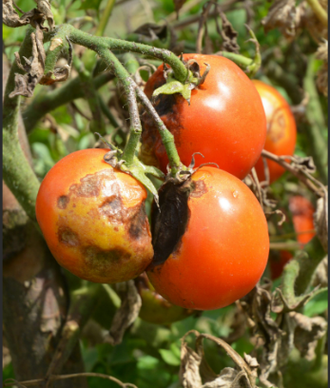
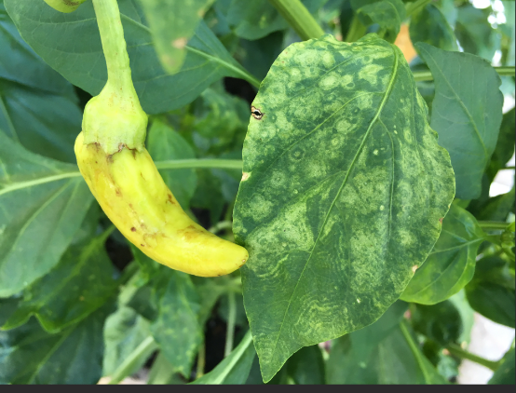
Crop name | Disease Name | Symptoms | Diseases Picture
Tomato | Late Blight | Humid conditions coincide with mild temperature for prolonged period. Irregular lesions on leaves greenish black and water soaked .Fruit lesions occur as large green to brown lesions on upper half of fruit .white moldy growth may also appear on fruits. Symptoms on fruits appear on shoulders of fruit.
Tomato | Tomato Spotted Wilt Virus | Occurs on leaves &fruits . Fruit shows numerous spots about one –half inch in diameter with concentric circular markings on ripe fruit which are alternate bands of red and Yellow.

Slide 7
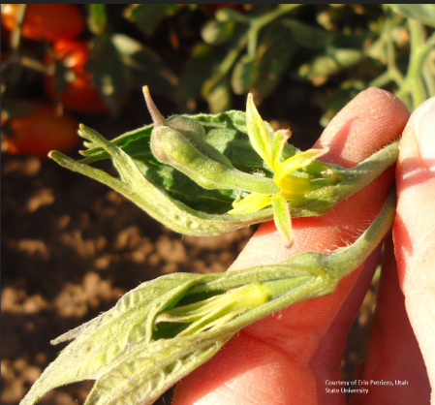
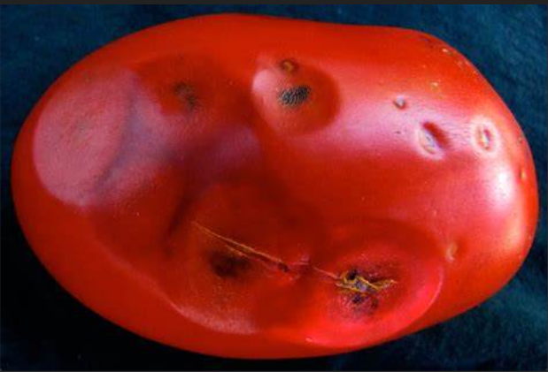
Crop name | Disease Name | Symptoms | Diseases Picture
Tomato | Tomato Big BUD | Transmitted by leaf Hopper. Symptoms on shoots actively growing. The youngest fruit becomes recurved in upright position. The Buds also point vertically . The Leaves becomes yellow and green and Role along their margins . Fruit remains Green at the time of Infection but becomes Hard and tough and colours extremely slowly or Not at all
Tomato | Anthracnose | Infected Fruits shows small , slightly sunken , Water soaked , spots. These spots Enlarged become darker in colors and depressed and have concentric rings . The Fungus penetrate the fruit completely and Destroying it. Fruit shows Marked lesions, when it ripens. Fruit becomes More susceptible as they approach Maturity

